Slide 1

Reinforcement Learning
Camelot
Joe Lanzi & Chien-Chou Wu

Slide 2
Agenda
About the project (intro)
Project Objective (motivation)
Sneak Peek (Everything done so far)
Project Stages
Phase 1
Phase 2
Phase 3
Project Demonstration

Slide 3
About the Project
Extend far beyond computer simulations and develop a custom deep artificial intelligence agent that can learn and evolve in an environment with changing economic conditions.
Environment developed in Camelot, a customizable 3D game engine used for interactive narrative research.
Multiagent reinforcement learning algorithm trained on life-like simulated scenarios
Notes:
shorten

Slide 4
Project Objective
Create a fully automated ecosystem of players using Reinforcement Learning which would allow the NPCs to automatically conduct various tasks and create settings similar to human behaviors without any written instructions.
Simulate a 3D environment using Camelot and train a reinforcement learning agent based on rewards, logic, and policies.
Conduct studies on the multiple layers introduced to the ecosystem such as a trading system, distribution of wealth, NPCs happiness, establishing supply and demand.
Notes:
shorten

Slide 5
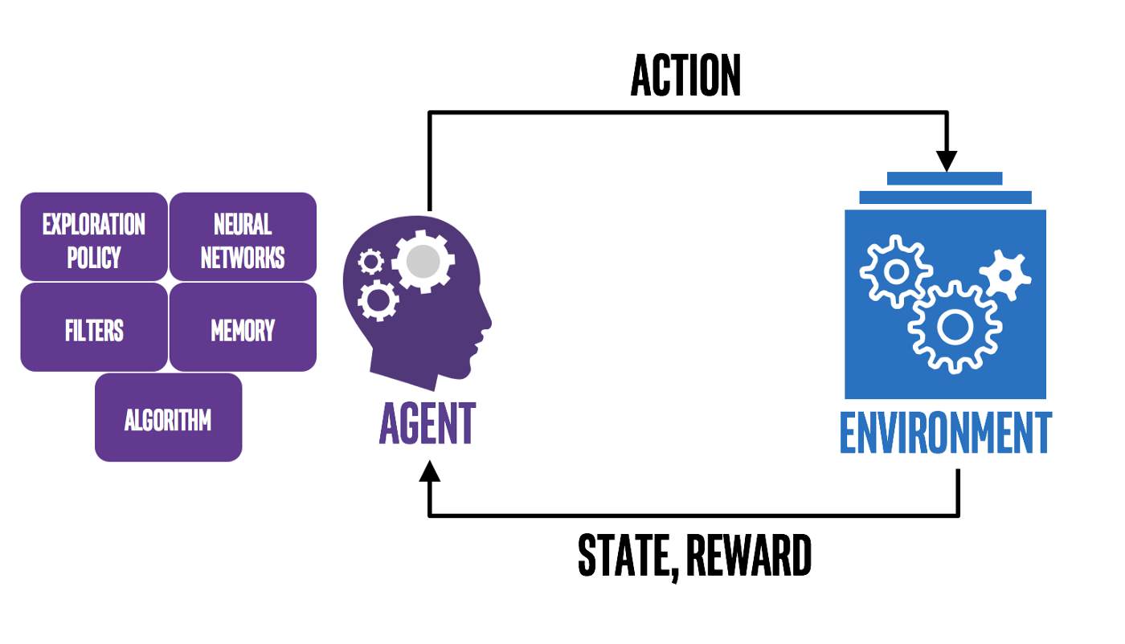

Ecosystem
ACTION
REWARD
OBSERVATION

Slide 6
Ecosystem
ACTION
POLICY
NEURAL NETWORK
FILTERS
MEMORY
REWARD
OBSERVATION

Slide 7
Artificial Intelligence Agent
POLICY
FILTERS
Predicting Actions
Strategies
Behaviors
Reading Input from Environment
Converting Output
MEMORY
NEURAL NETWORK
Observations
Behaviors
Experiences
Deep Reinforcement Learning
Proximal Policy Approximation
Collects small batch of experience in its decision-making to update its gradient policy method

Slide 8
Proximal Policy Optimization (PPO) Model (2017)
Deep Reinforcement Technique
Policy Gradient Method
Derivation from DQN (2014) & TRPO (2015)
DQN was unstable & not data efficient
TRPO tried to fix this with an optimization function but too complex
Stable & Compatible with multiple networks simultaneously
Faster and Easier to implement
Notes:
DQN value policy method
unstable – cant run well in complex environments
not data efficient
trust region policy optimization (trpo)
utilizes optimization function
avoids parameter updates that change the policy too much
too complex
2017
rely upon optimizing parametrized policies with respect to the expected return (long-term cumulative reward) by gradient descent (measuring loss)
Gradient descent is an optimization algorithm used to minimize some function by iteratively moving in the direction of steepest descent as defined by the negative of the gradient

Slide 9
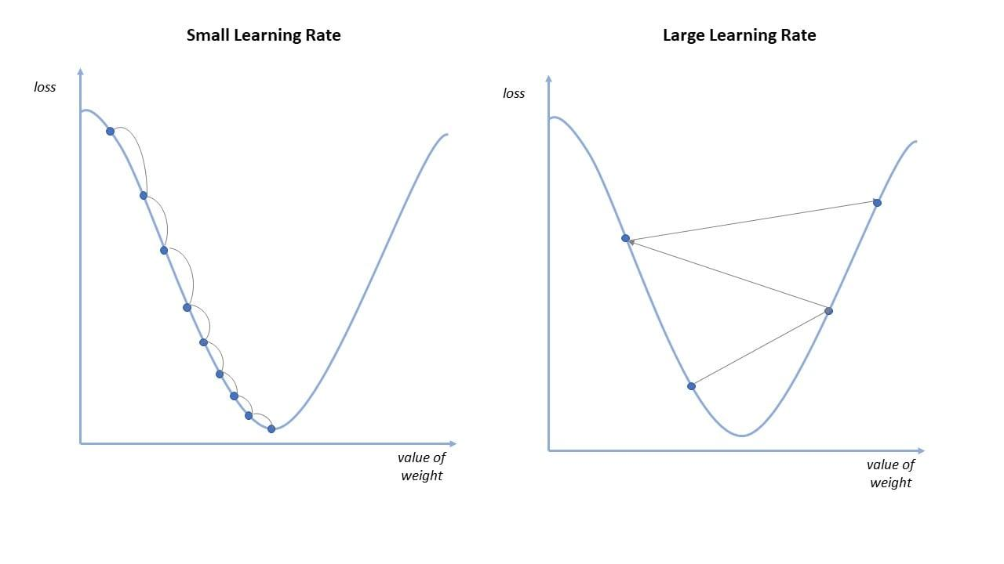
Gradient Descent
Notes:
DQN value policy method
unstable – cant run well in complex environments
not data efficient
trust region policy optimization (trpo)
utilizes optimization function
avoids parameter updates that change the policy too much
too complex
2017
rely upon optimizing parametrized policies with respect to the expected return (long-term cumulative reward) by gradient descent (measuring loss)
Gradient descent is an optimization algorithm used to minimize some function by iteratively moving in the direction of steepest descent as defined by the negative of the gradient

Slide 10
Why use PPO?
ease of implementation, less complexity, & ease of tuning
Notes:
DQN value policy method
unstable – cant run well in complex environments
not data efficient
trust region policy optimization (trpo)
utilizes optimization function
avoids parameter updates that change the policy too much
too complex
2017
rely upon optimizing parametrized policies with respect to the expected return (long-term cumulative reward) by gradient descent

Slide 11
Ecosystem
ACTION
POLICY
NEURAL NETWORK
STATE
RULES
FILTERS
MEMORY
NPCs
ITEMS
REWARD
OBSERVATION

Slide 12
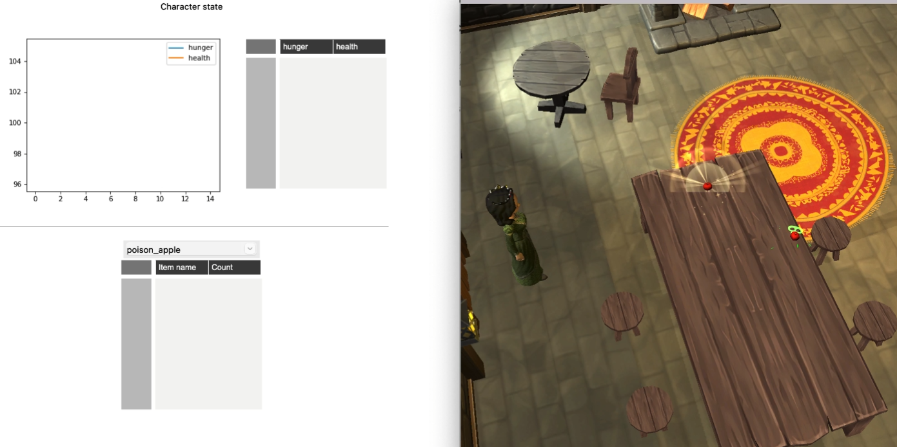
Camelot: Narrative Interactive Projects

Slide 13
Environment
STATE
RULES
Health, Hunger, Energy
NPC, entity, item locations
Happiness (Reward)
Cost of survival
Discrete Actions
Laws and Limits
NPCs
ITEMS
Different Occupations
Special Skills
Fully Automated
Effects
Cost
Quantity

Slide 14
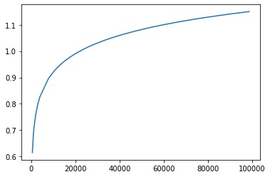
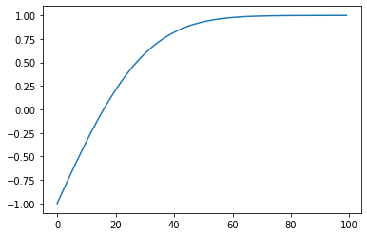
Reward
0.5 per second alive + happiness
Happiness = health + hunger + energy + wealth [-3 to 3]
Log Function
(Wealth)
Gauss Error Function
(Health, Hunger, Energy)

Slide 15
Simulation
Without AI
10,000 episodes
Avg: 40-50 steps/seconds
With AI
10,000 episodes
Avg: 1mil steps/seconds (indefinite)

Slide 16
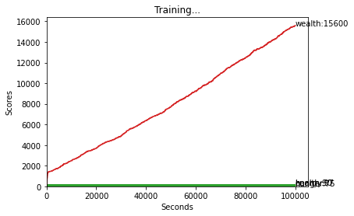
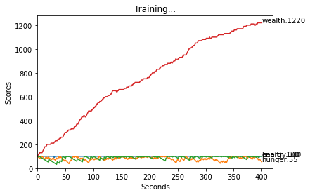
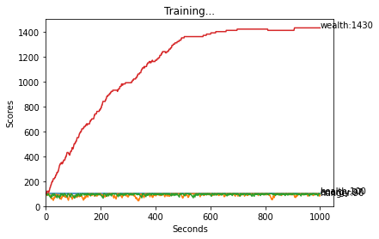
Simulation

Slide 17
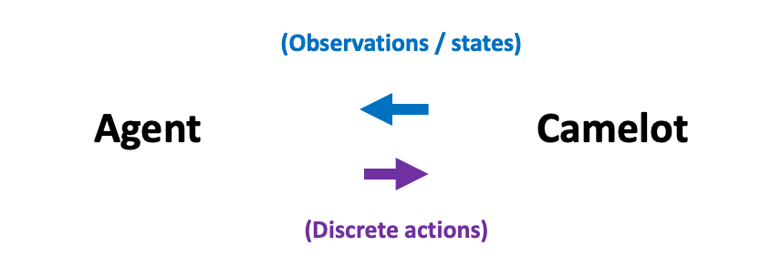
Integration
Agents outputs/inputs Camelot inputs/outputs
Agents
Outputs
Discrete actions [0, 1, 2, …]
Inputs
Observations from Camelot actions
Camelot
Outputs
Observations after actions
Inputs
Discrete action from agents

Slide 18

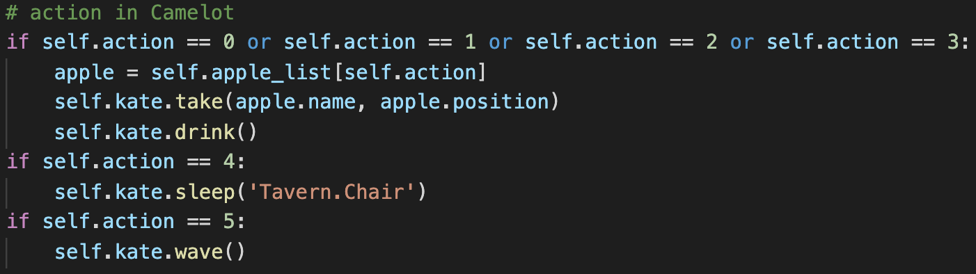
Integration
Agents outputs/inputs Camelot inputs/outputs

Slide 19
GUI
States line chart, States table, Items table

Slide 20
Project Stages
First sprint (Feb 4th - Feb 18th)
Created the World & NPCs
Created class for NPCs / Items
Created a simple RL model
Simulation environment completed
Agent completed
Good rewards ( 1 million steps surviving)
Second sprint (Feb 18th - Mar 4th)
Integrate Simulation with Camelot
NPC controlled by Agent
Simple state logic completed
Good visualization via GUI

Slide 21
Project Stages
Third sprint (Mar 4th - Mar 18th)
Introduce trading systems, supply and demand
Improve state logic & reward strategy
Create a nondeterministic environment
Strengthen the gui
Forth sprint (Mar 18th - Apr 1st)
Add more complex layers to agents (multi agents)
Give NPCs occupations
Try more scenarios if possible
Conduct studies from environment changes

Slide 22
Demo

Slide 23
Questions

